Slide 1
Self service password reset system
Rohit Khapare
Chintan Gosalia

Slide 2
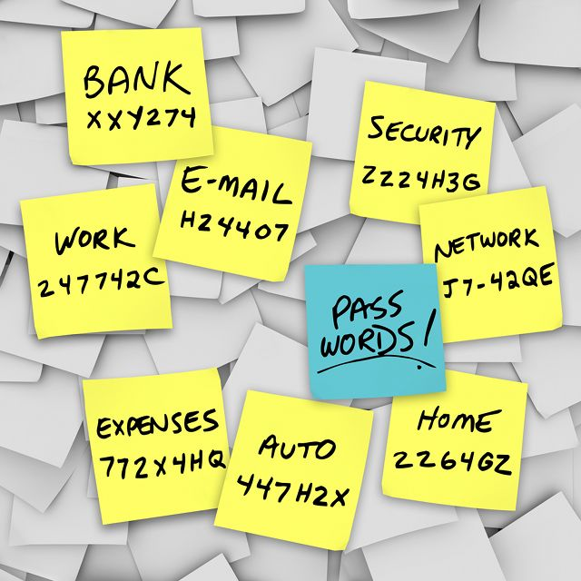
Background
Passwords : a way to identify the user
Password fatigue

Slide 3


Slide 4
Related work we referred
Personal knowledge questions for fallback authentication: Security questions in the era of Facebook
- Ariel Rabkin, UC Berkeley
A few surveys described by
it.slashdot.org
zdnet.com
theatlantic.com

Slide 5
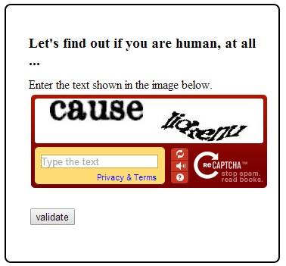
implementation
Recaptcha generation and verification using recAPtcha api

Slide 6
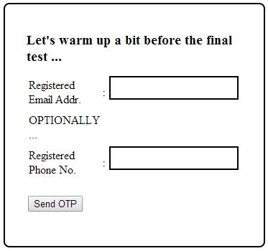
implementation
Otp generation and communication via email and text message

Slide 7
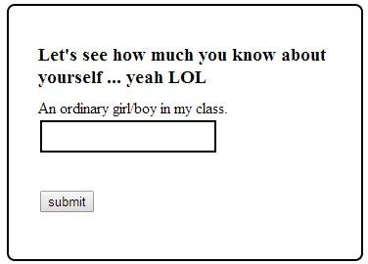
implementation
Security questions

Slide 8
evaluations
A password reset request not initiated by a user does not require any action
Only the owner of a valid email address/phone number will be able to reset his password
peer survey conducted to evaluate the strength of our proposed model of security questions

Slide 9
conclusions
opportunity to analyze existing password reset infrastructure
STUDIED THE USEFULNESS AND WEAKNESS OF EXISTING SECURITY QUESTIONS
PROPOSED A MODEL THAT CAN HELP REVIVE SECURITY QUESTIONS

Slide 10
Thank you!!!

